Slide 1
Climate Change: A visual through environmental shifts
Duy Mai
Hoang-Uyen Tran
Twan Tran
CECS 450 – Data Visualization

Slide 2
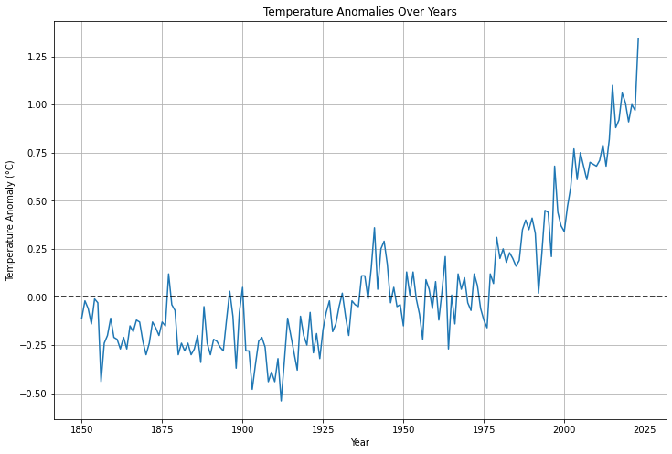
WHAT IS CLIMATE CHANGE?
Climate change, often referred to as global warming, or the greenhouse effect, is a change in the Earth's average temperature and cycles of weather patterns caused by human activities over a long period of time.
These have been recorded since 1850 in various parts of the world by means of thermometer-based records. There is a clear upward trend in terms of temperature data across the globe suggesting warming trend. The rising temperatures represent an evident sign of climate change.
Greenhouse gases (GHGs) like CO2, CH4, and N2O are the primary cause.
GHGs create a blanket effect in the atmosphere, trapping heat.
Result: Earth's temperature increases.
Consequences: Extreme weather events, rising sea levels, and disruptions in ecosystems.

Slide 3
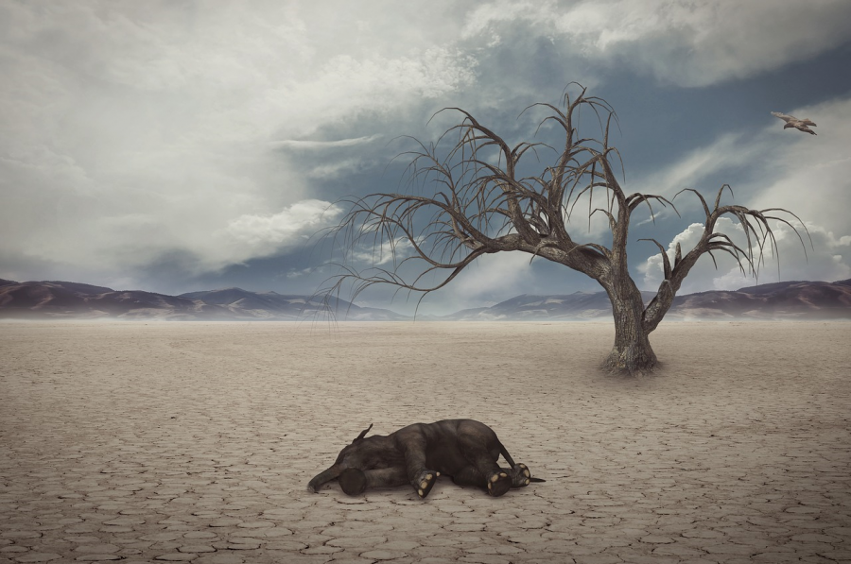
WHY IS IT A PROBLEM?
Over a long period of time species adapt gradually to fit well with their environment. This is supported by a stable climate that facilitates growth and adaptation of life. But rapid climate changes present a challenge: this implies that, organism has very short time for adaptation. Such rapid changes may sometimes prove hard for certain species to adapt with and consequently threaten them existence in a new surroundings.

Slide 4
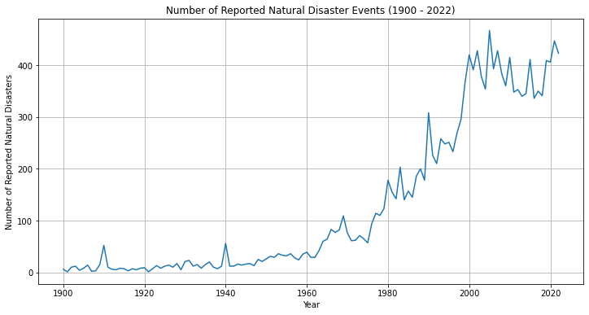
Why is It a problem?
Changes in climate cause different types of weather and more frequent extreme weather patterns. Such changes involve rising in the number of hurricanes, prolonged droughts, and more severe flooding.
However, at the same time, one should take into account an association between increasing average temperatures around the world and rising numbers of witnessed natural disasters.

Slide 5
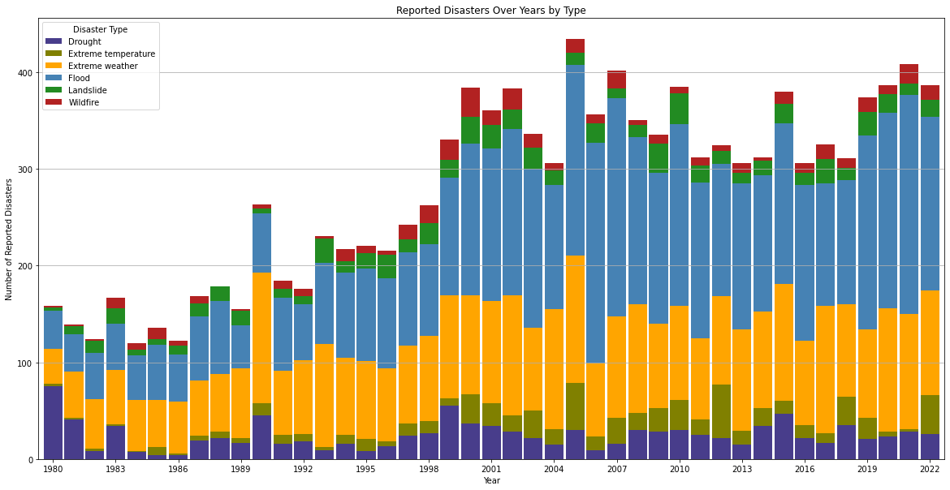
The frequency of various types of disasters has increased for the last three decades, starting with year 1980. As the temperature keeps rising the amount of flooding, landslides, and even wildfire has increased significantly. Furthermore, there has been more extremes of wind, heat and drought than used to be in times past.
Why is It a problem?

Slide 6
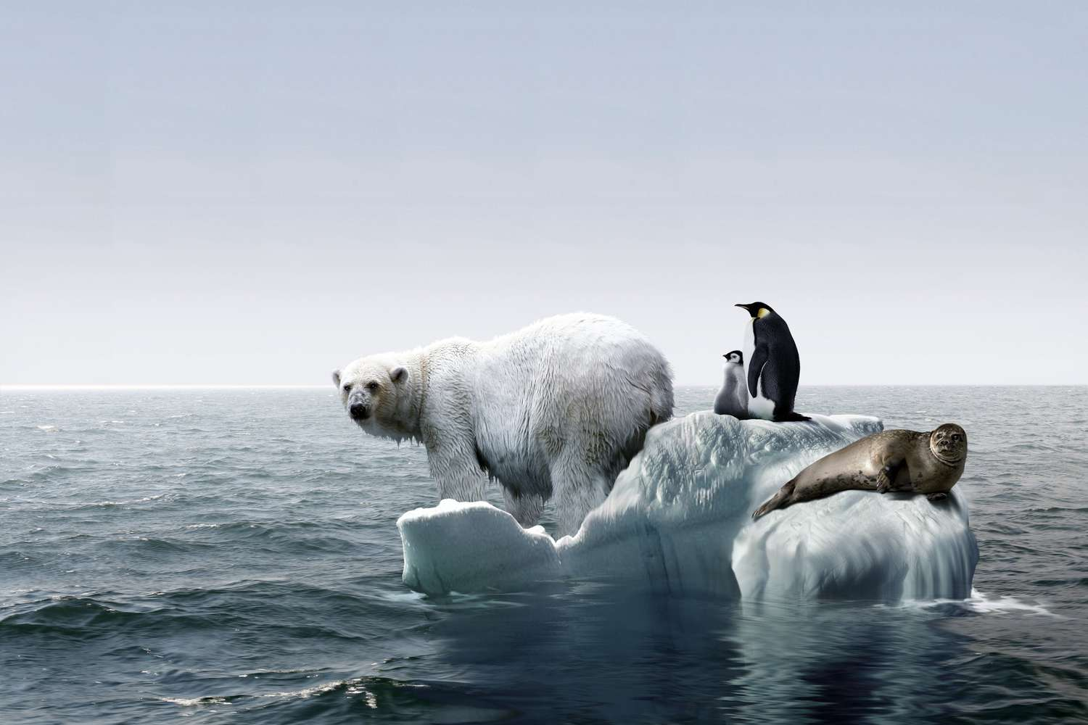
WHY IS IT A PROBLEM?
The retreat of sea ice caused by increasing global temperatures has reduced the area of ice where many polar mammals engage in vital pursuits such as feeding, mating, and resting. This change poses a lot of problems to creatures like polar bears and seals by messing up with their feeding grounds as well as the breeding zones. The declining of ice makes it difficult the animals to find food and place of breeding as a well the rest.

Slide 7
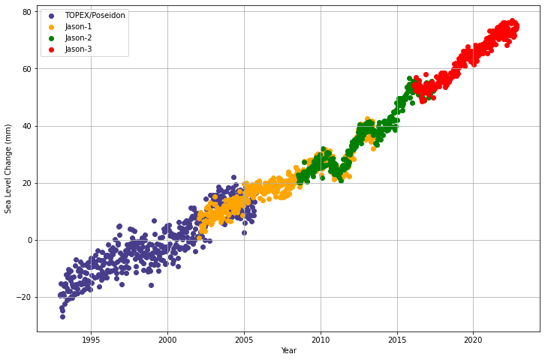
WHY IS IT A PROBLEM?
Sea levels are rising as a result of increasing temperatures.
Over time, this can lead to high tides that flood coastal areas and destroy habitats thereby relocating entire communities living in flatlands/low-lying areas.
Rising sea levels are driven by two main processes:
Ice Melt: Warming up of air and sea leads to melting of the ice sheets and glaciers, consequently adding salt-less water into sea water.
Thermal Expansion: The increase in sea levels can be attributed to increasing temperatures of ocean water that causes it to expand.

Slide 8
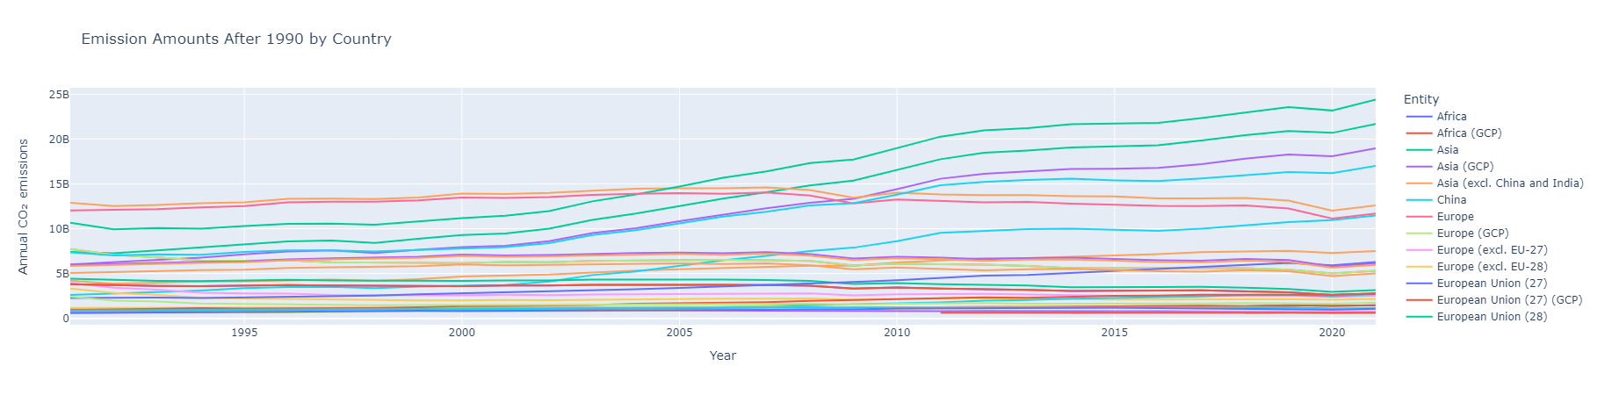

Slide 9
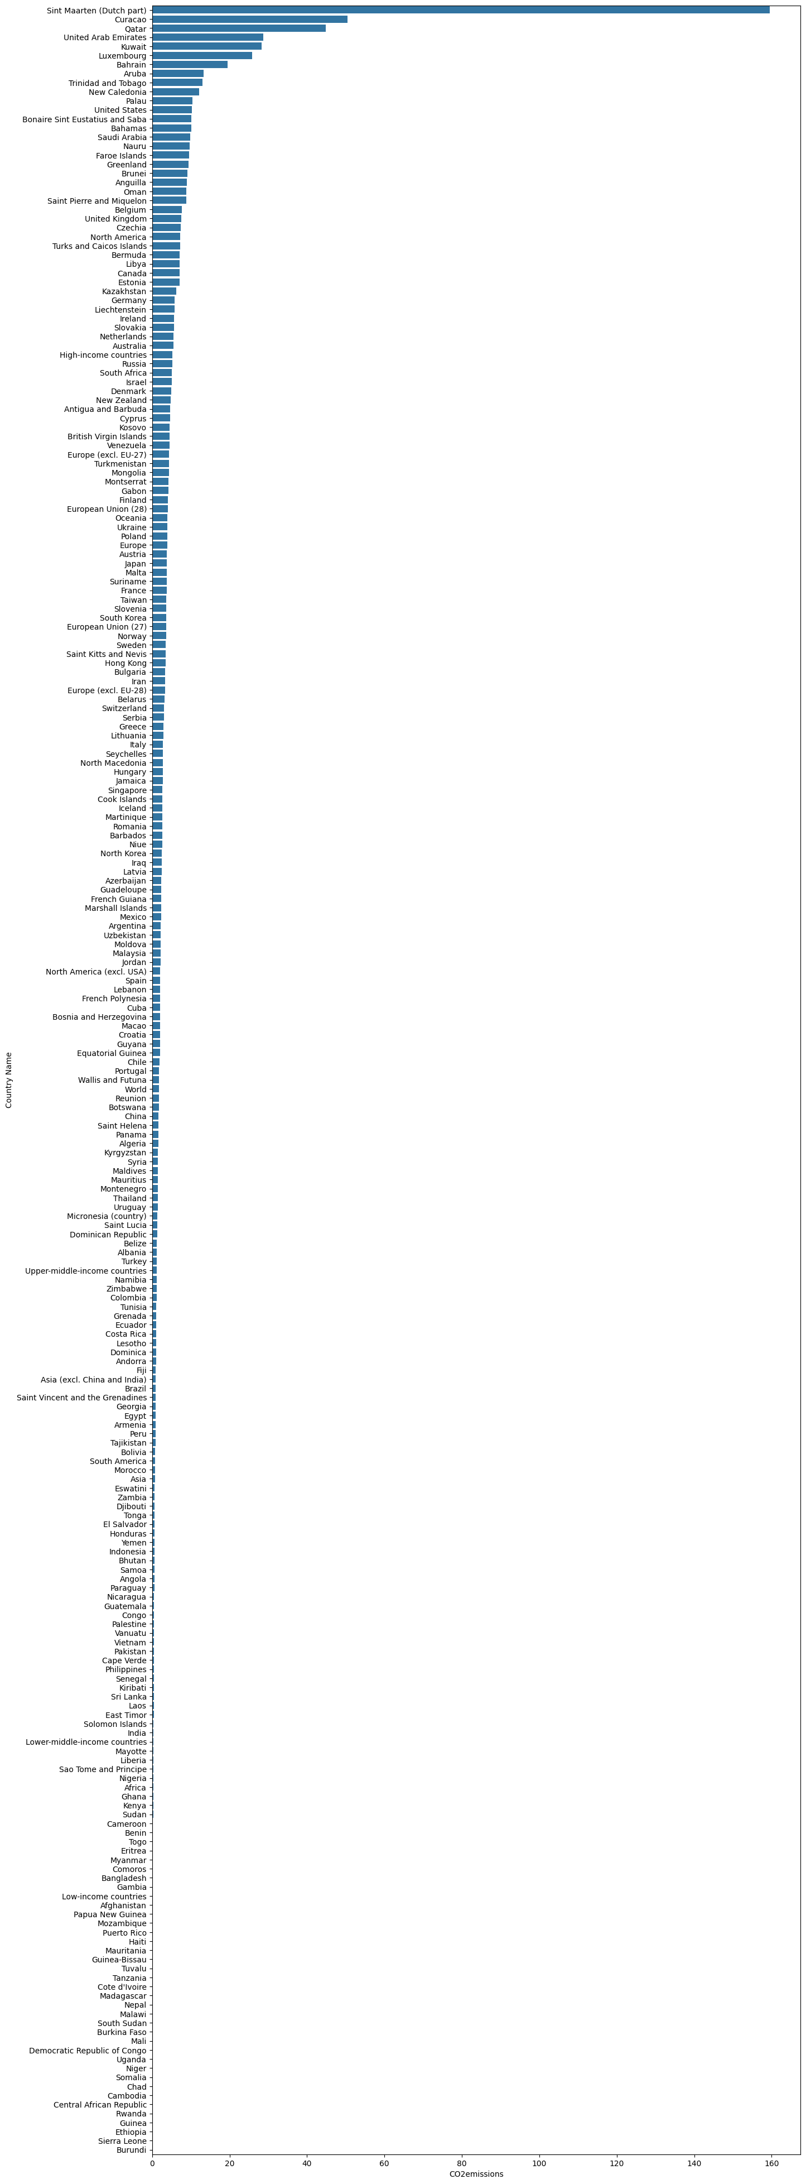

Slide 10
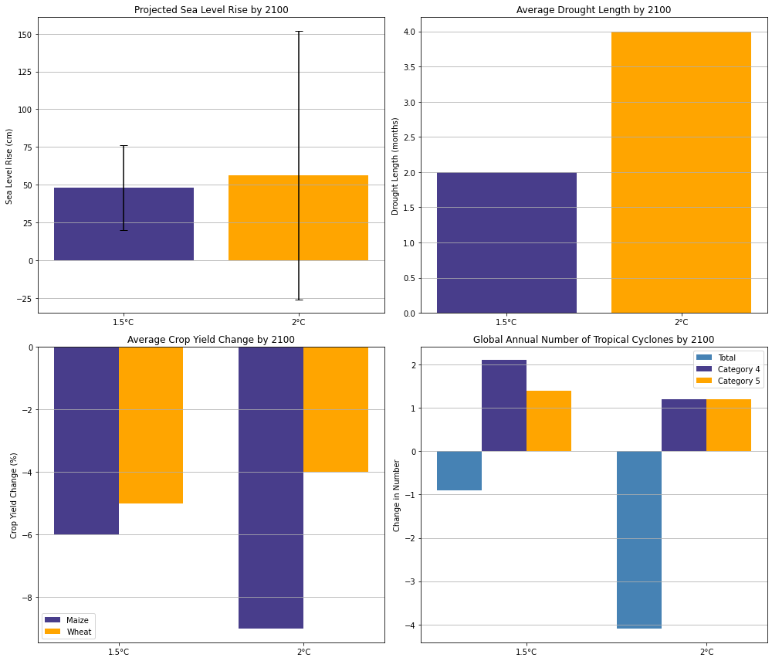
Why is It a problem?

Slide 11
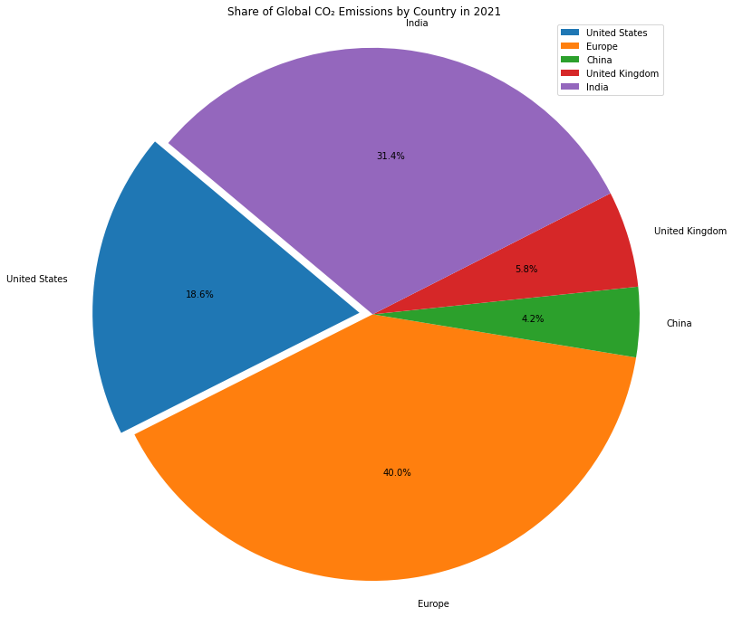
Who Causes Climate Change?
It is estimated that around 1% of greenhouse gases in the question of global warming are said to originate from the 50 most less-developed countries. On the other hand, inputs by the U.S, EU, and China accumulate about 60% of the World’s CO2 Emission.

